Slide 1
2016 Election Data Analytics
By Alahnah, Alejandra, and Raven

Slide 2

Introduction
Selecting the Data
GeoJSON
Html/ETL
API Flask
JavaScript
Conclusion

Slide 3
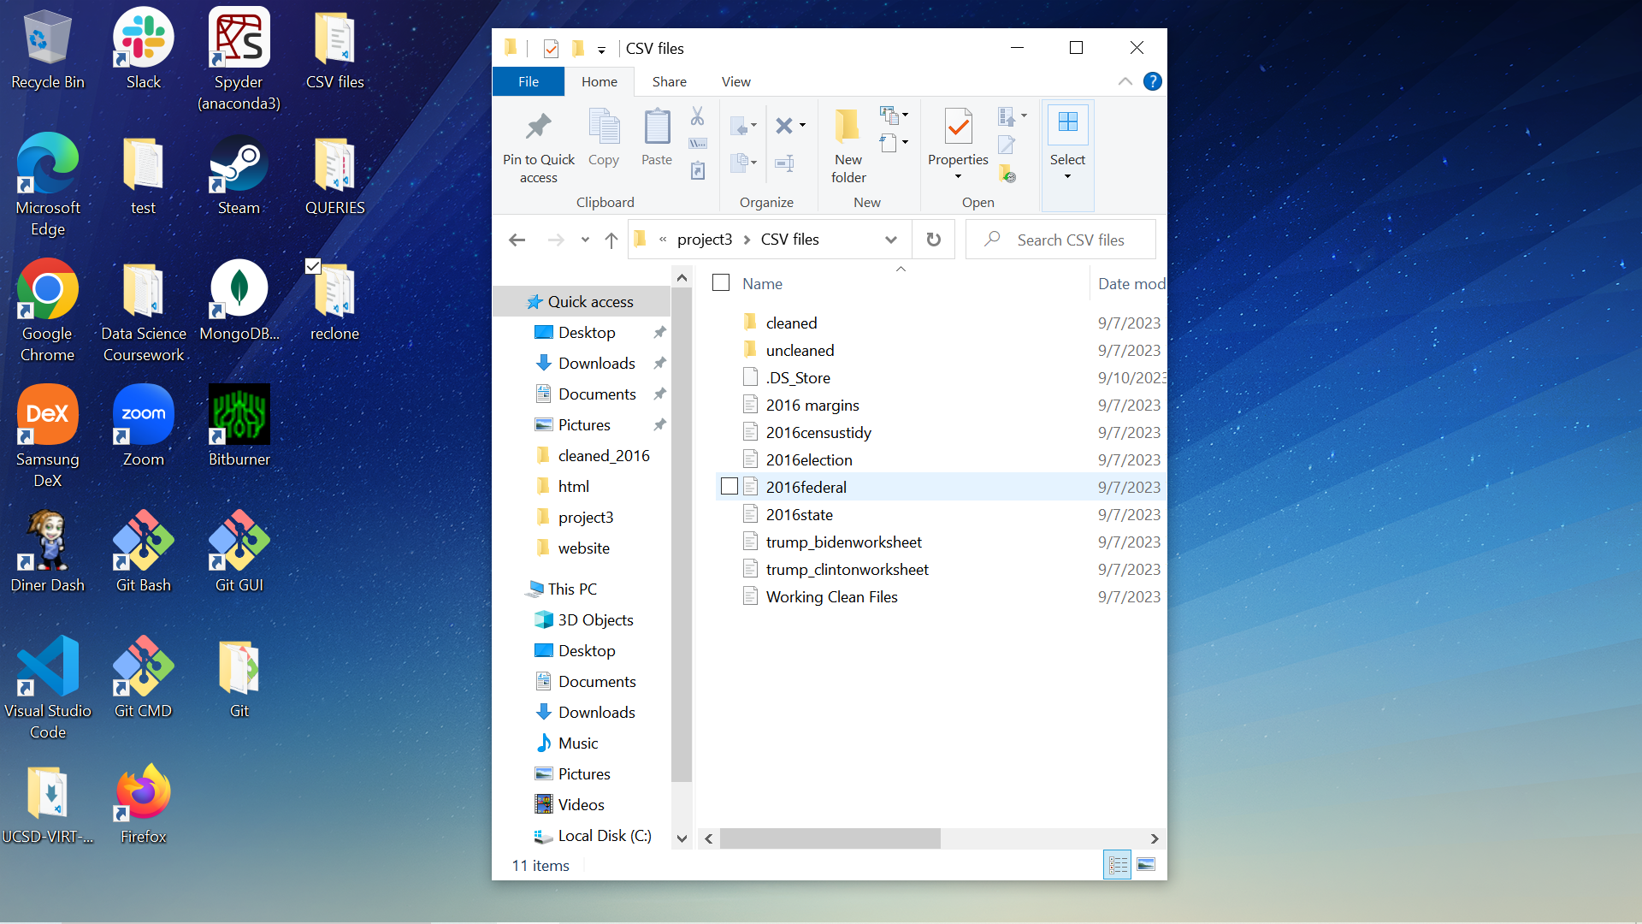
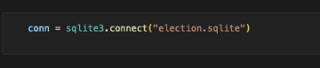
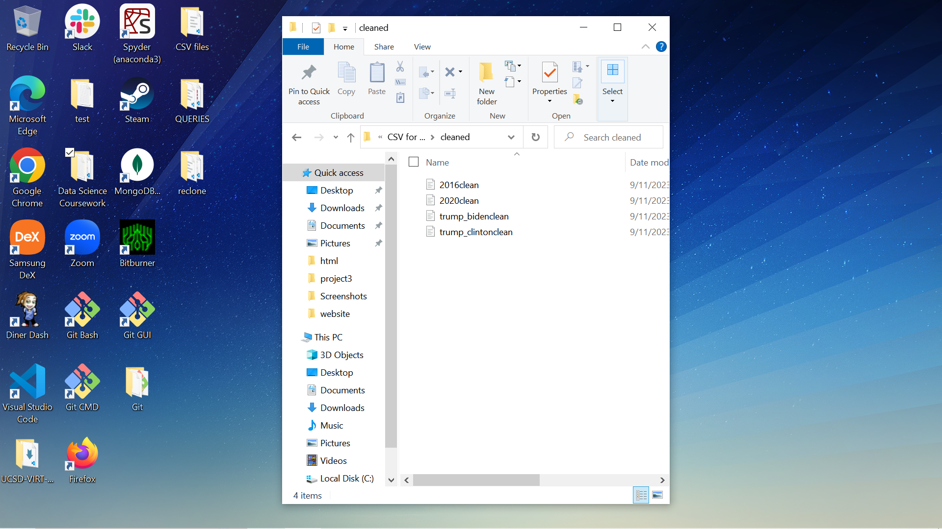
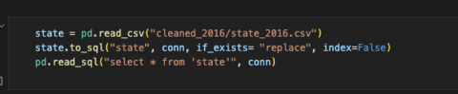
Selecting the Data/ETL
Original Data Sources
Re-Start
Switched to Alejandra’s Data Sources
Added tables to SQLite Election DB

Slide 4
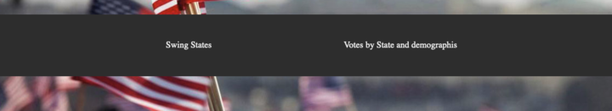
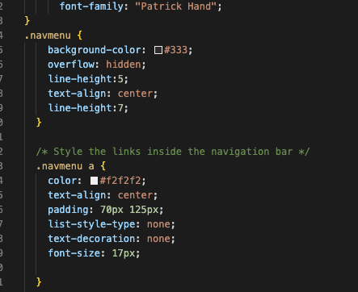
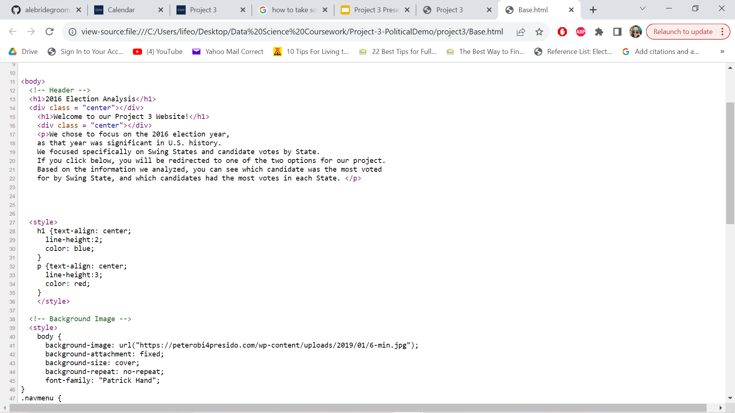
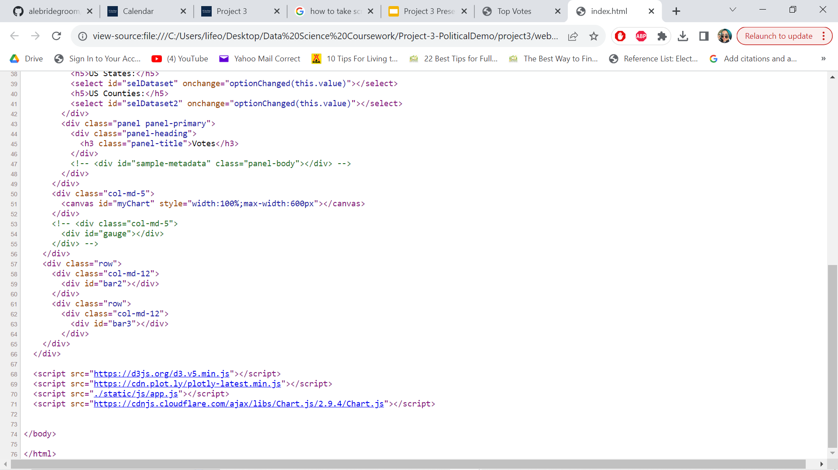
HTML
Double-Checking Styles
Correcting Spacing
Changing Colors
Nav-Bar with two pages
Chart JS

Slide 5
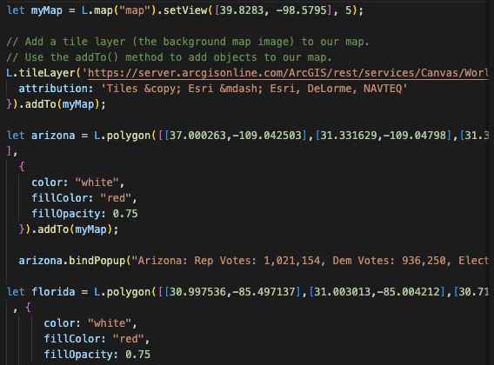
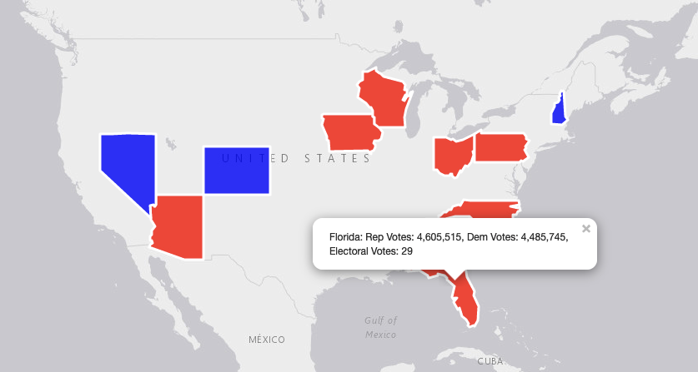
GeoJSON
Leaflet Json file of states
Limited datasets
Districts GeoJson
Merging two Json files

Slide 6
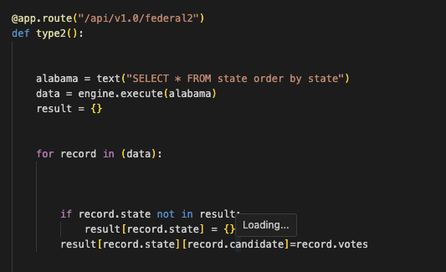
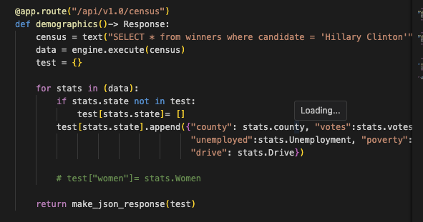
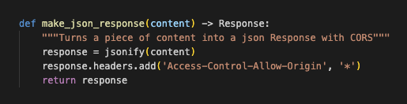
API Flask
Struggle: not being able to use sql alchemy and settling on using plain sql.
Made the states keys again with each demographic for each county
Made the states the keys and the votes the values so i can graph this for the states graph

Slide 7
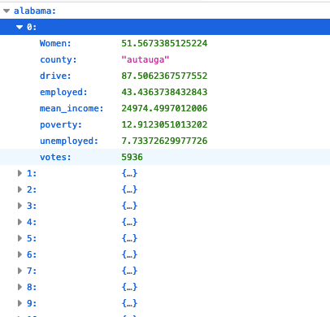
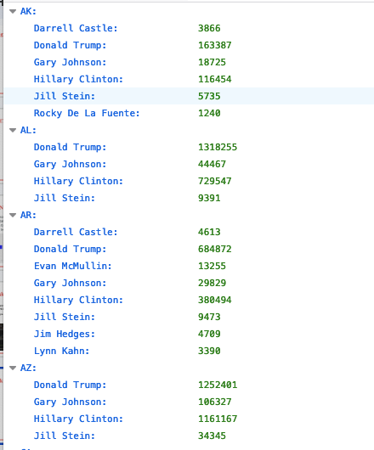
API flask continued

Slide 8
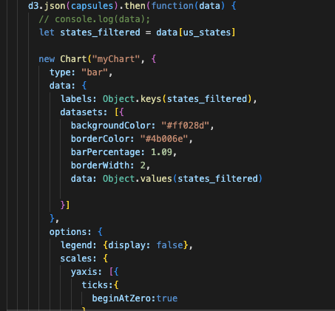
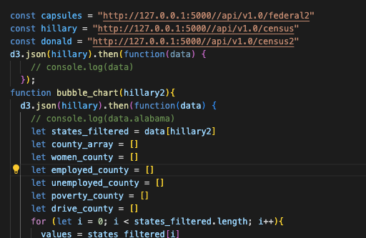
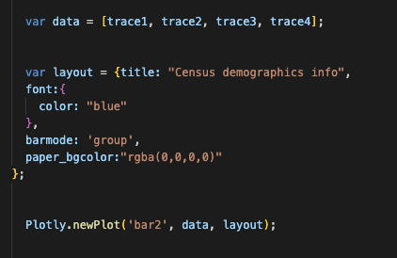
JavaScript

Slide 10

Conclusion
WE DID IT, JOE!!!
WE FINISHED PROJECT 3!!!

